Slide 1

AirBNB Hotel Booking Analysis
[ Nandini Banothu ]
[STU67d8f2bc5fd0b1742271164]

Slide 2

PROBLEM STATEMENT
Airbnb Hotel Booking Analysis.
This project focuses on analyzing Airbnb’s operations in New York City, a major hub for tourism and short-term lodging. By examining the New York City Airbnb dataset, the study employs data cleaning, exploratory analysis, and visualization techniques to uncover patterns and insights in the local lodging market. The analysis aims to identify factors that influence listing availability, pricing strategies, and overall customer satisfaction, providing a deeper understanding of how Airbnb functions in a competitive urban environment. The findings offer valuable guidance for hosts, guests, and stakeholders, helping them navigate and make informed decisions in the evolving landscape of short-term accommodations.

Slide 3
Project Description
This project focuses on analyzing Airbnb’s operations in New York City, a major hub for tourism and short-term lodging. The study leverages a dataset containing Airbnb listings in the city to uncover patterns and insights about the local lodging market.
The analysis begins with data cleaning to ensure accuracy and reliability, followed by exploratory data analysis (EDA) to examine trends in availability, pricing, and customer reviews. Visualization techniques are employed to make the findings more understandable and actionable.
By identifying factors that influence listing availability, pricing strategies, and overall customer satisfaction, the project provides valuable insights for hosts, potential guests, and stakeholders interested in the short-term accommodation market. The outcomes highlight how Airbnb operates in a competitive urban environment, offering guidance for decision-making and strategic planning.

Slide 4

WHO ARE THE END USERS?
Airbnb management
property hosts
marketing teams

Slide 5

Technology Used
pandas
numpy
matplotlib
seaborn

Slide 6
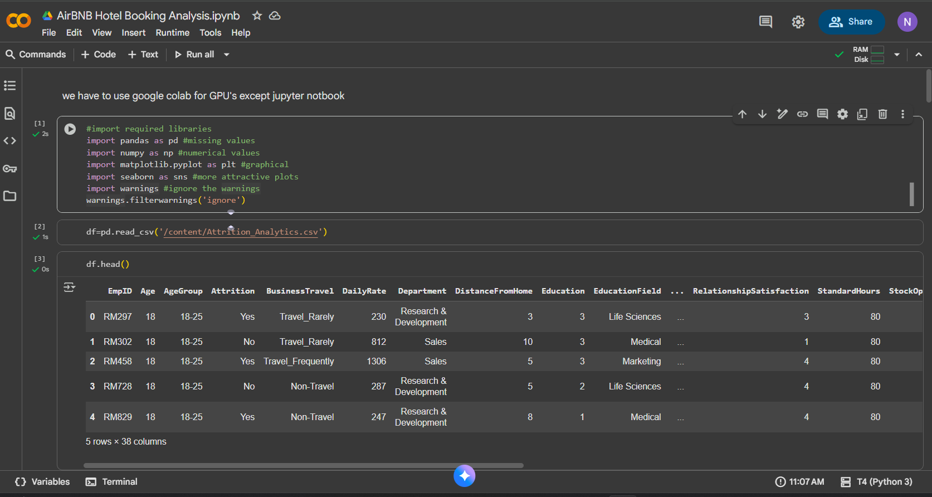
RESULTS1
[Add screen shots of your code or Chart(s) ]
Demo Link

Slide 7
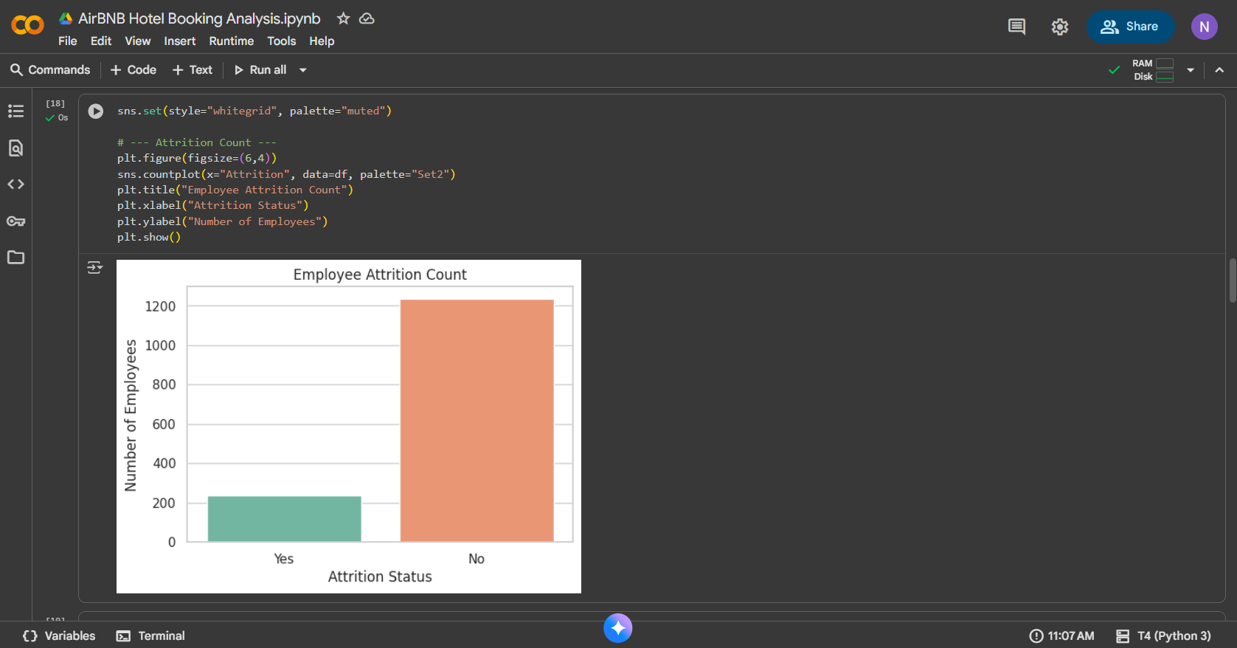
RESULTS2
[Add screen shots of your code or Chart(s) ]
Demo Link

Slide 8
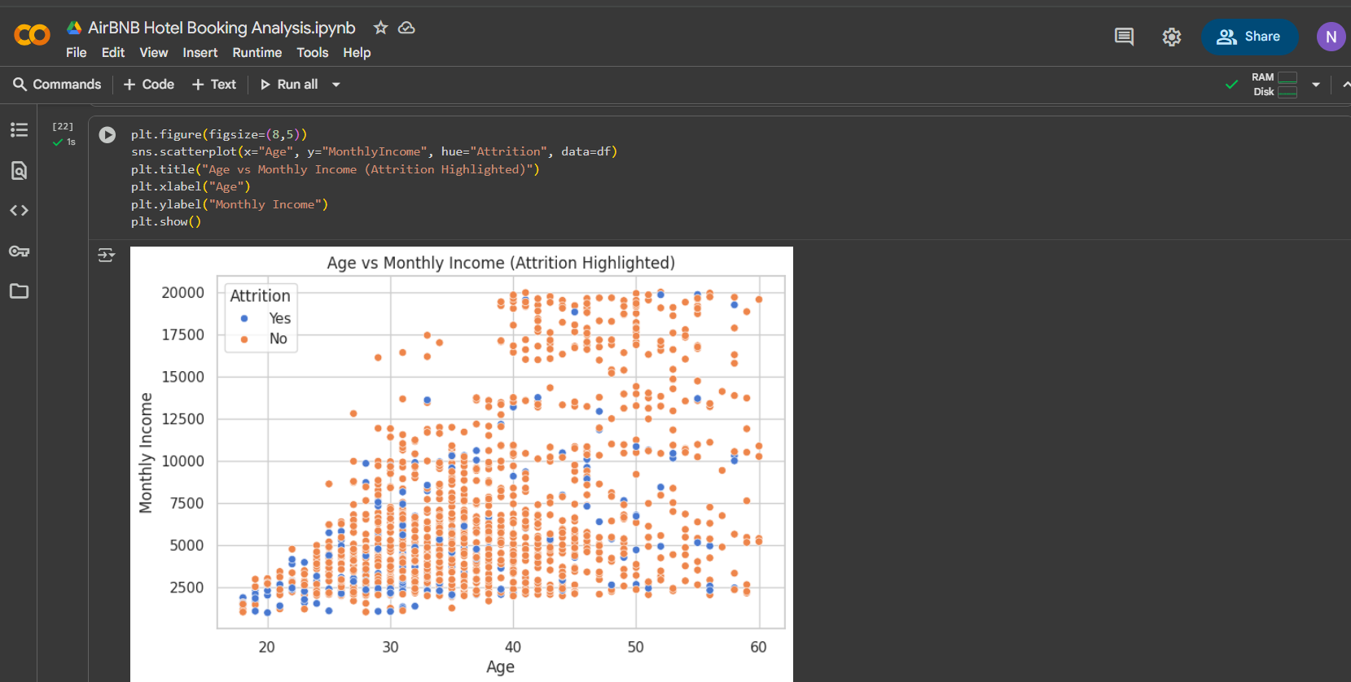
RESULTS3
[Add screen shots of your code or Chart(s) ]
Demo Link

Slide 9
GitHub repository
Git hub: https://github.com/Nandini-Banothu1114/VOIS_AICTE_Oct2025_Nandini-Banothu.git
Demo Link

Slide 10

Getting started with Basics of Python Certificate
[Paste your Certificate Here]

Slide 11

Data Visualization Certificate
[Paste your Certificate Here]

Slide 12
Thank you
I’m thankful for the opportunity to work on this project, which helped me enhance my analytical and technical skills.
.
.

